Slide 1
Classification and clustering of bank data using Hadoop, Pig and R
GUIDED BY,
Dr.S.BALAKRISHNAN,
Department of Information Technology,
SKCET.
PROJECT SUBMITTED BY,
AGILAN S 15EUIT003
ARUN KUMAR A K 15EUIT011
FAHEEN FATHIMA B N 15EUIT030
VINITHA B 16EUIT518

Slide 2
EXISTING SYSTEM
“According to RBI statistics, a bank can handle 8,00,00,000 transactions in a single month”
KAGGLE COMPETITIONS:
“An important part of succeeding as an insurance company is having a good understanding of which of the company’s current customers will be with the company into the future. The goal of this competition is to predict which current customers will still be with the company in 6 months, given many of the customer’s characteristics.”
“Using an anonymized database of information on customer and sales activity, including property and coverage information, Homesite is challenging you to predict which customers will purchase a given quote. Accurately predicting conversion would help Homesite better understand the impact of proposed pricing changes and maintain an ideal portfolio of customer segments.”

Slide 3
PROPOSED SYSTEM
Using Hadoop ecosystem to perform analysis over the bank customer data
Classifying customers into High, Medium and Low risk customers.
Clustering and analysing the clusters.
Classification using Hadoop framework and Apache Pig
Clustering and analysis using R Programming

Slide 4
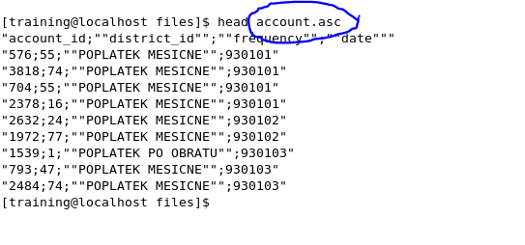
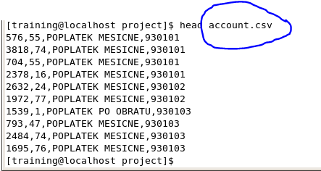
MODULE-1 PREPROCESSING DATA

Slide 5
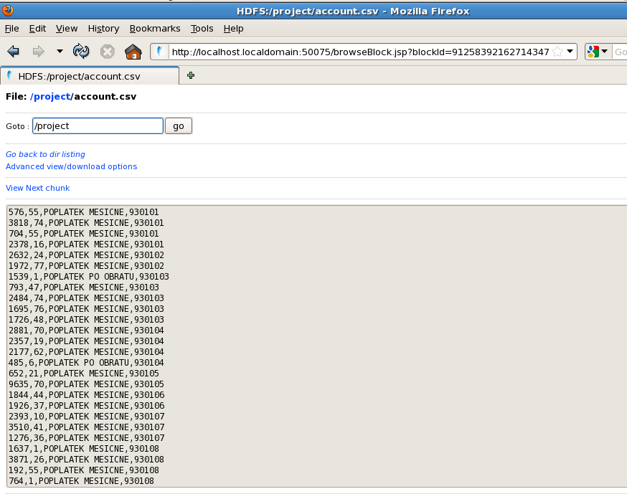
LOADING DATA INTO HDFS

Slide 6
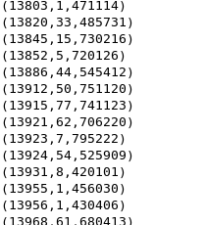
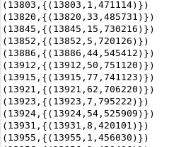
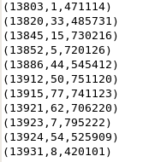
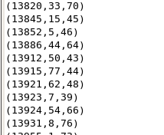
MODULE 2 PROCESSING OF DATA
CLIENT-FIELDS = CLIENT ID, BIRTHNUMBER,DISTRICT ID
INSERTING FIELDS
FORMING TUPLES
FLATTENING TUPLES
FINDING AND INSERTING AGE

Slide 7
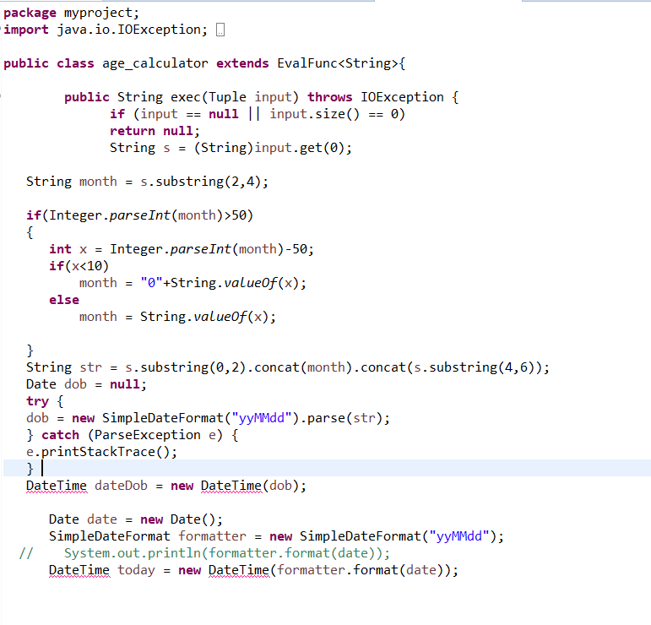
USING OF JAR FILES

Slide 8
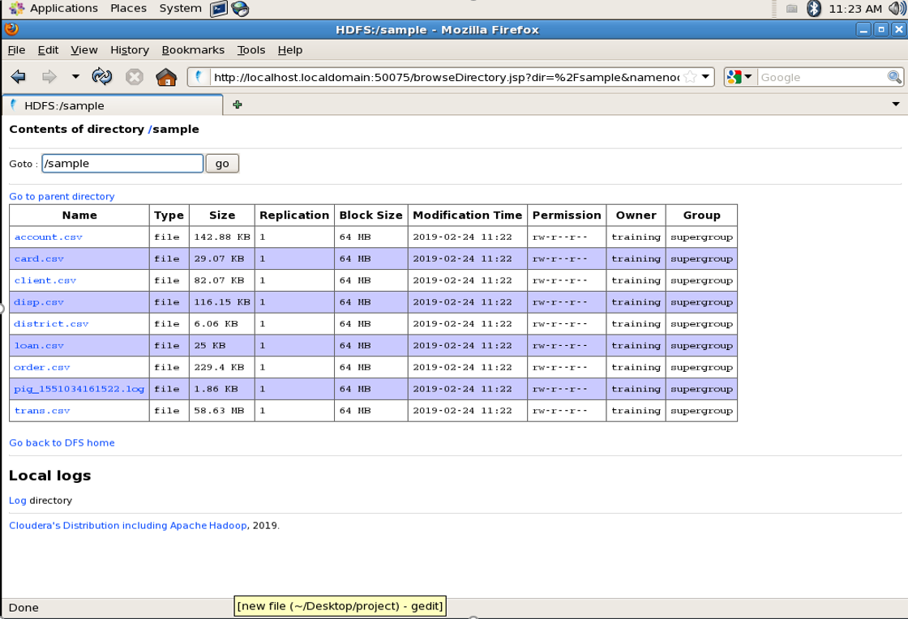
MODULE 3 EXTRACTING DATA

Slide 9
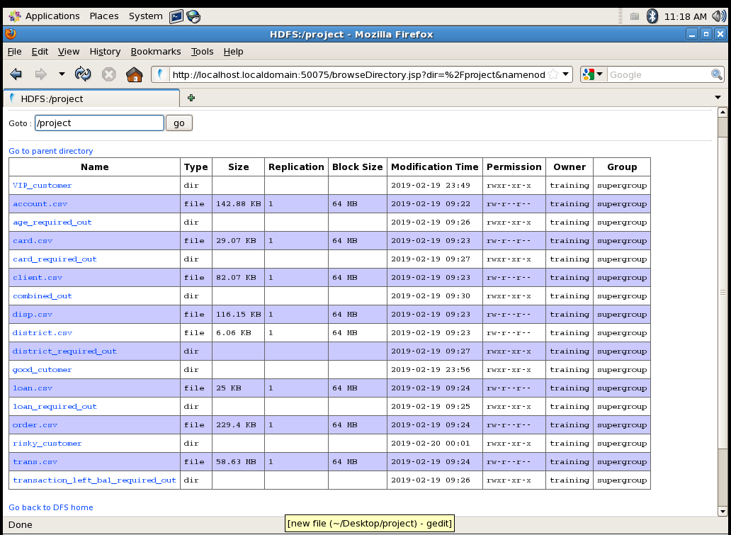

Slide 10
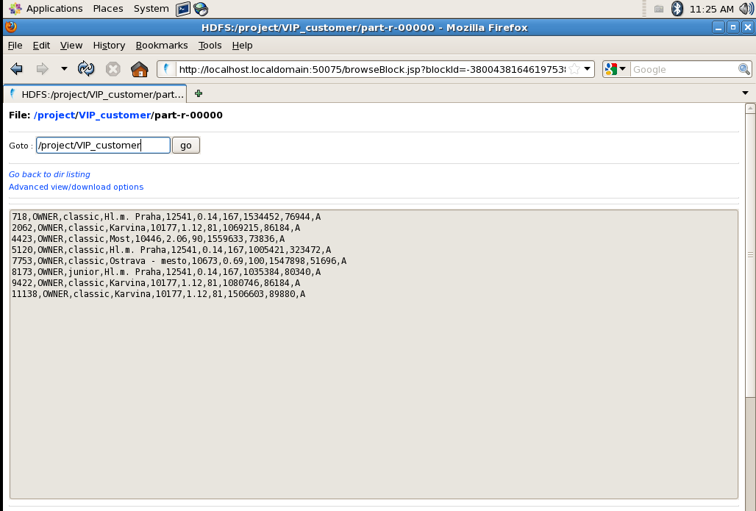

Slide 11
THANK YOU!
Parameters considered
Transaction amount
Loan status
Credit card status
Average salary
Age
Unemployment rate
Entrepreneurship rate
Disposition

